Slide 1
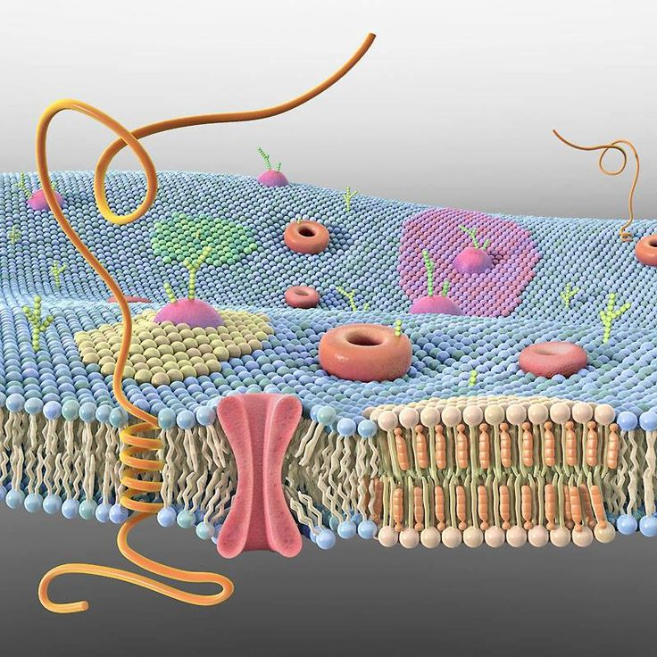
The cell membrane
AEHBY ATAR Human Biology

Slide 2
Review
Define cytoplasm
2. State the function of
nucleus
mitochondria
microtubules
3. Explain the difference between cilia and flagella
4. State the difference between rough and smooth ER

Slide 3
Learning Intentions
The cell membrane separates the cell from its surroundings with a structure, described by the fluid mosaic model, which allows for the movement of materials into and out of the cell by osmosis, simple diffusion, facilitated diffusion, active transport and vesicular transport (endocytosis/exocytosis)

Slide 4

Success Criteria
Describe the fluid mosaic model
List the functions of the cell membrane
Describe cell membranes as semi-permeable
Define osmosis, simple diffusion, facilitated diffusion, active transport and vesicular transport (endocytosis/exocytosis)

Slide 5
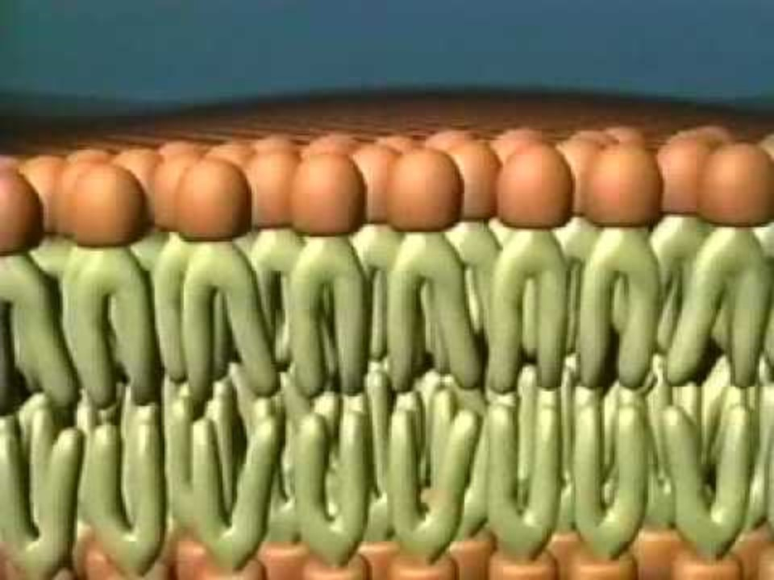
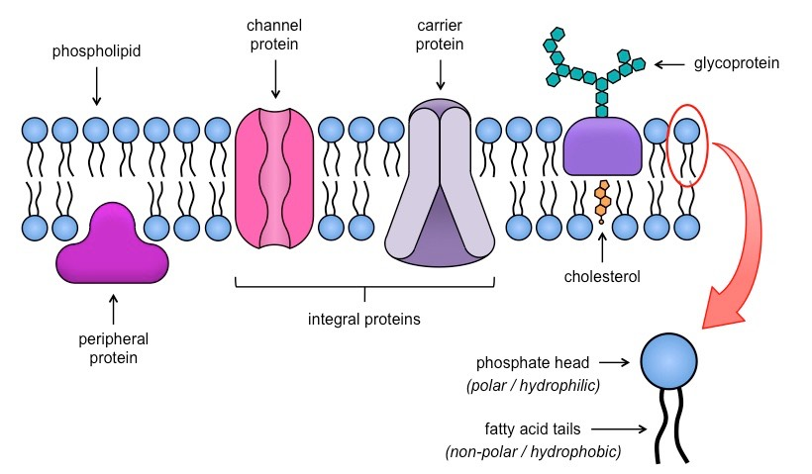
The fluid mosaic model

Slide 6
Functions of the cell membrane
Physical barrier between cytoplasm and extracellular fluid
Regulates movement of materials between cytoplasm and extracellular fluid (ions, nutrients, wastes, secretions)
Sensitivity to changes in the extracellular fluid (receptors)
Supports the cell (along with microfilaments of the cytoskeleton) and connects to adjacent cells to support tissues.

Slide 7
Transport across the cell membrane
The cell membrane is
semi-permeable (selectively permeable):
some substances can move freely in and out of the cell, but others are restricted.

Slide 8
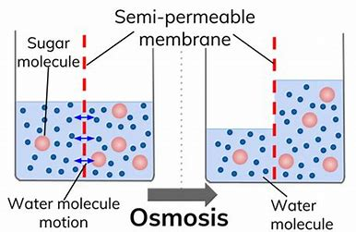
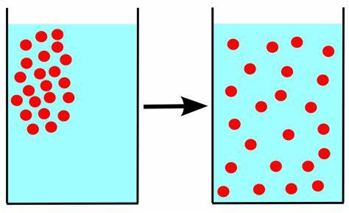
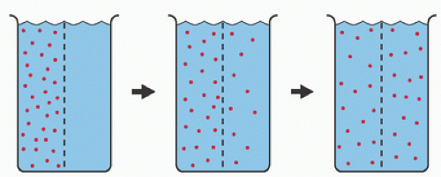
Transport across the cell membrane
Simple diffusion
– passive
- ions and small molecules
- move from high to low concentration
- (osmosis is a special type of simple diffusion

Slide 9
Transport across the cell membrane
Facilitated transport
- requires channel proteins (passive) for larger molecules eg glucose
or carrier proteins (active)
for moving against a concentration gradient, eg ions

Slide 10
Transport across the cell membrane
Vesicular transport
- active transport
- membrane-bound sacs (vesicles)
- endocytosis or exocytosis
- pinocytosis (liquids) or phagocytosis (solids)

Slide 11
Success Criteria
Describe the fluid mosaic model
List the functions of the cell membrane
Describe cell membranes as semi-permeable
Define osmosis, simple diffusion, facilitated diffusion, active transport and vesicular transport (endocytosis/exocytosis)

